Slide 1



Leveraging Analytics for Enhanced Airbnb Operations in Chicago.
Prashast Vaish,
Vishnu Anand,
Swanand Gaikwad

Slide 2







Agenda
Introduction
Exploratory Data Analysis (EDA)
Data Modelling
Airbnb Business Model Super Host Certification Program
Tried multiple models to train our data
Problem Statement
Data
Modification
Business Insights
& Way Forward
Data Set Description and Identification of trends & Patterns in Raw Data
Airbnb Perspective
Host Perspective
Potential Investor
Prepared our Data
for Extensive Data Modeling
Recommendations for the stakeholders and future scope

Slide 3
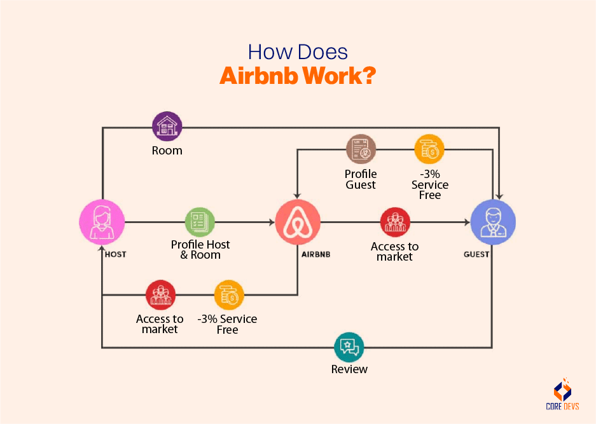

Slide 4
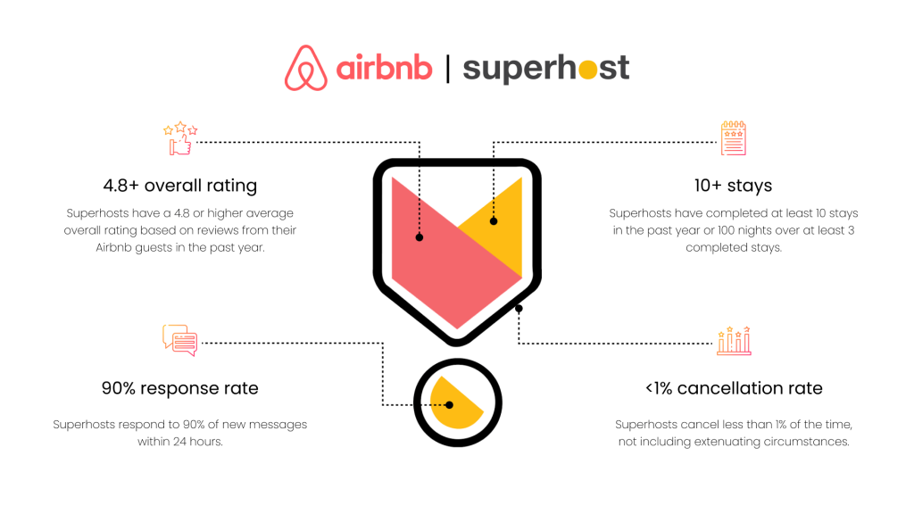
SUPER HOST CERTIFICATION PROGRAM
The Superhost certification program creates value for all stakeholders throughout the Airbnb ecosystem.

Slide 5



Improved Guest Satisfaction
Draws guests looking for premium accommodations, enhancing satisfaction levels.
Assurance of Quality
The visible Superhost badge signifies dedication to providing exceptional service.
Trust & Confidence
Dependable hosts with favorable reviews create a superior guest experience.
Higher Earnings
Increased bookings and credibility allow Superhosts to charge premium rates, resulting in higher revenues.
Increased Bookings
Builds trust among guests, driving more bookings and boosting earning potential.
Competitive Edge
Establishes elevated benchmarks, motivating hosts to consistently deliver quality experiences.
How it’s a Win-Win-Win!

Slide 6
Problem Statement
01
03
Evaluate the robustness of the current evaluation framework and propose additional factors.
Effectiveness of Superhost Program
Occupancy Rate Prediction
Provide actionable insights and recommendations to address challenges to drive business growth.
Assess the Superhost program's effectiveness by validating the criteria used to determine host eligibility.
Analyze how Superhost status impacts occupancy rates, to optimize hosting strategies.
02
04
Reassessment of Superhost Evaluation Criteria
Strategic Insights and Suggestions

Slide 7
Actionable Frameworks
Utilizing statistical techniques like causal analysis and hypothesis testing to calculate the efficacy of Superhost program.
Identified a significant correlation between Superhost status and higher occupancy rates. Superhost status serves as a key driver of guest trust and booking preferences, enabling targeted hosting strategies to maximize occupancy and revenue potential.
01
03
02
04
Utilizing Machine learning techniques like Logistic Regressions, Random Forest and Gradient Boosted Trees to identify the best model and predict potential superhosts for the upcoming period.
Identified key challenges and provided targeted recommendations, including operational optimization, improved customer engagement, and strategic investments to drive business growth.

Slide 8








Data Set Information
Avg. Occupancy Rate
The average occupancy rate is 19%, reflecting the proportion of time properties are booked. This provides insights into property utilization.
Avg. Rating Overall
Time Period
The average property rating is 4.74, reflecting high guest satisfaction and overall listing quality.
The dataset spans 16 time periods, enabling trend analysis to understand seasonality and market dynamics.
Super Host Status
Airbnb Dataset
Avg. Booked Days
The dataset includes 4,810 superhosts, highlighting exceptional performers with high ratings and consistent bookings.
On average, properties are booked for 26 days, offering insights into stay durations and demand patterns.
Avg. Revenue
Number of Entries & Attributes
Hosts earn an average revenue of $3,031, showcasing the potential earnings for Airbnb hosts.
The dataset includes 120,000 rows and 95 columns, providing detailed property and performance data for analysis.
Total No. of Hosts
There are 13,689 hosts in the dataset.
Notes:
© Copyright PresentationGO.com – The free PowerPoint and Google Slides template library

Slide 9
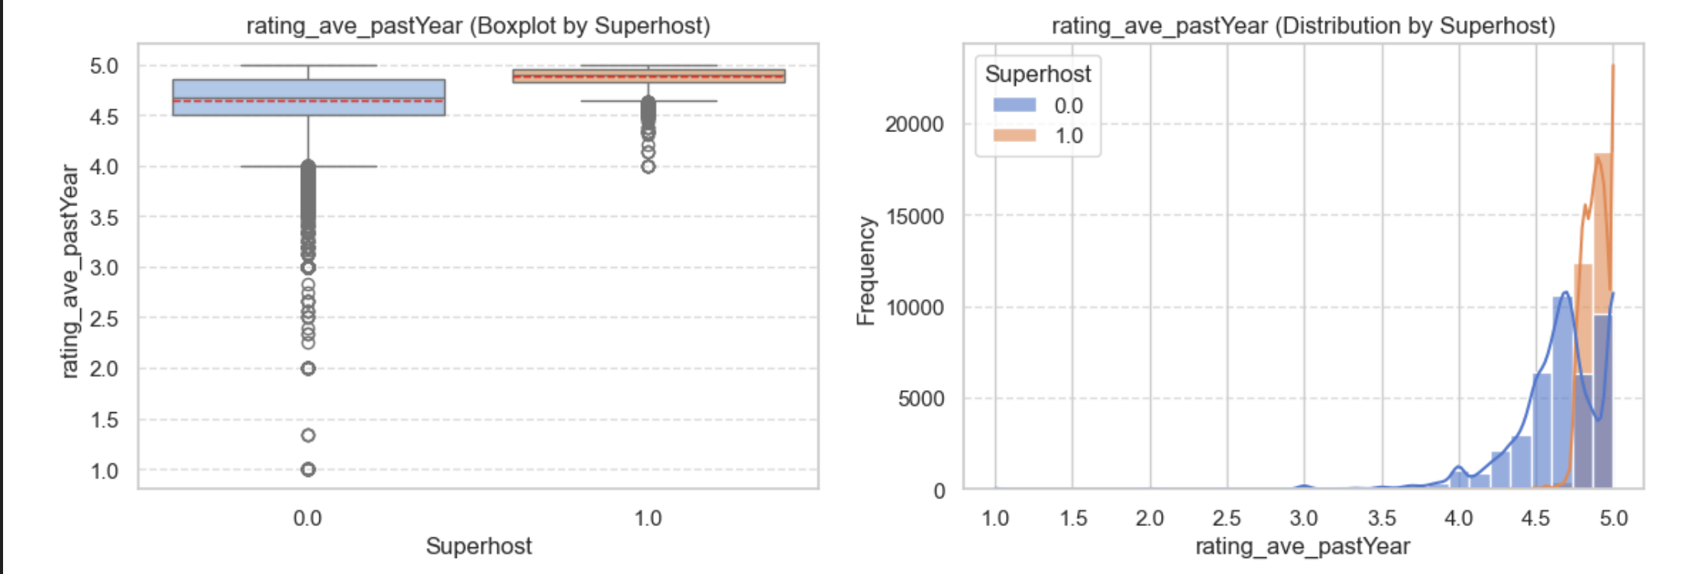
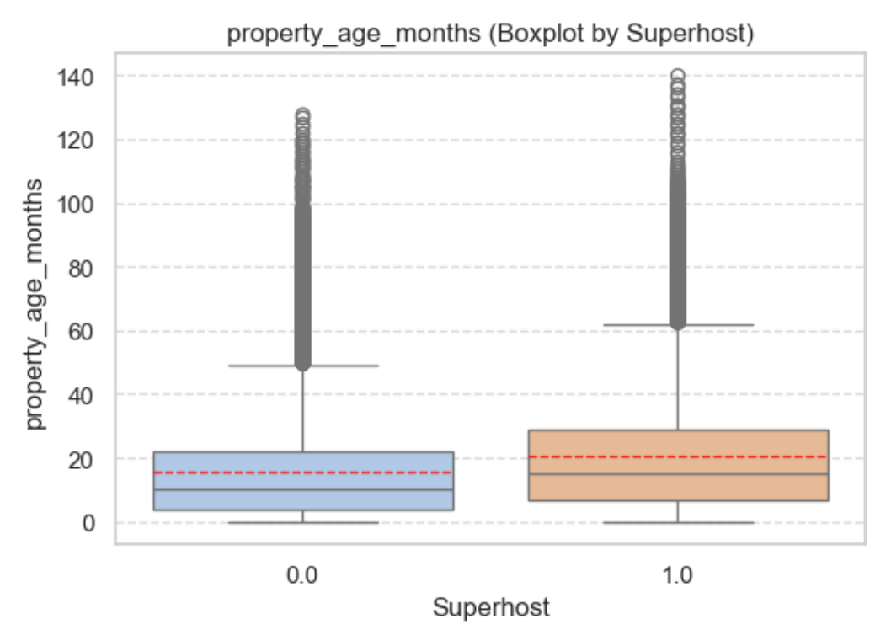
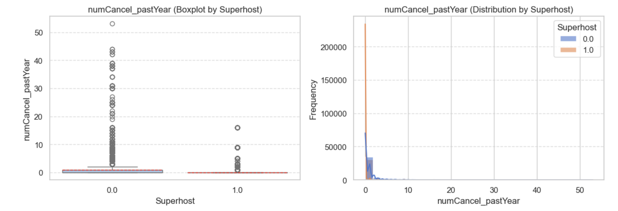
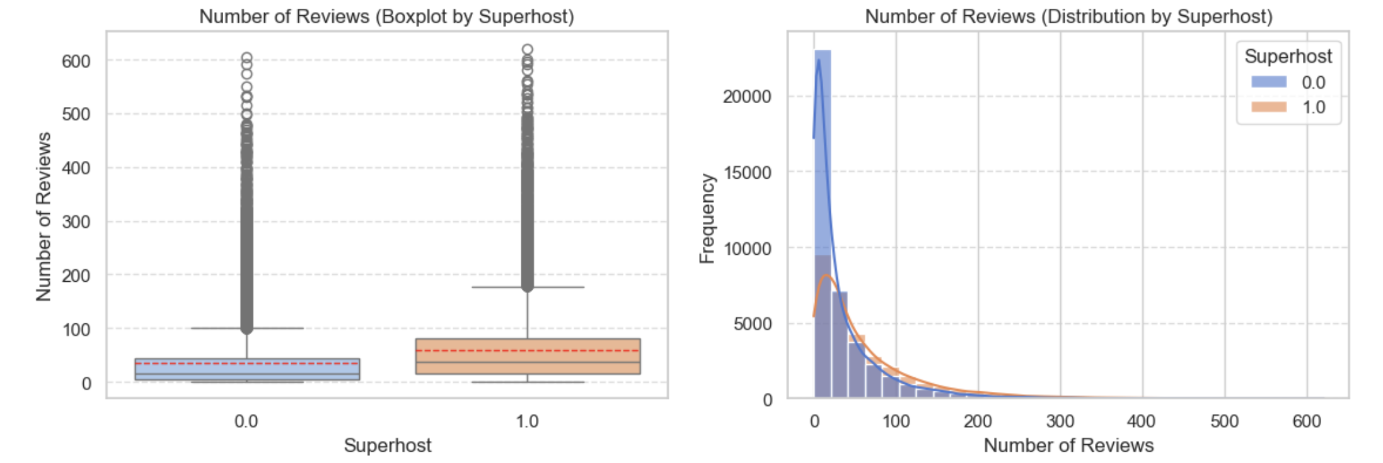
Exploratory Data Analysis

Slide 10
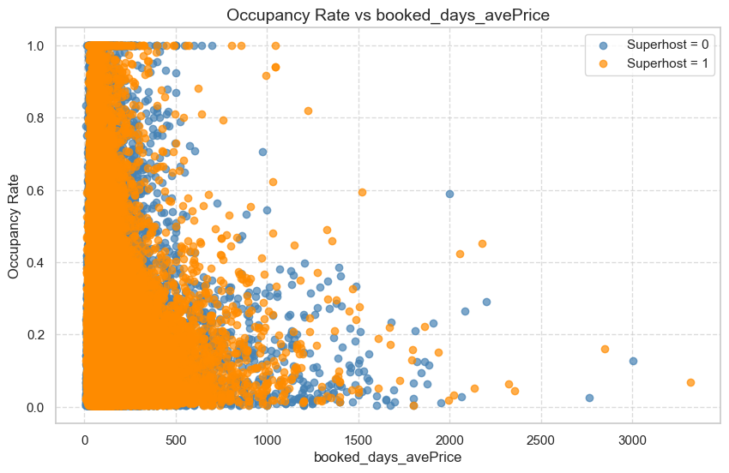
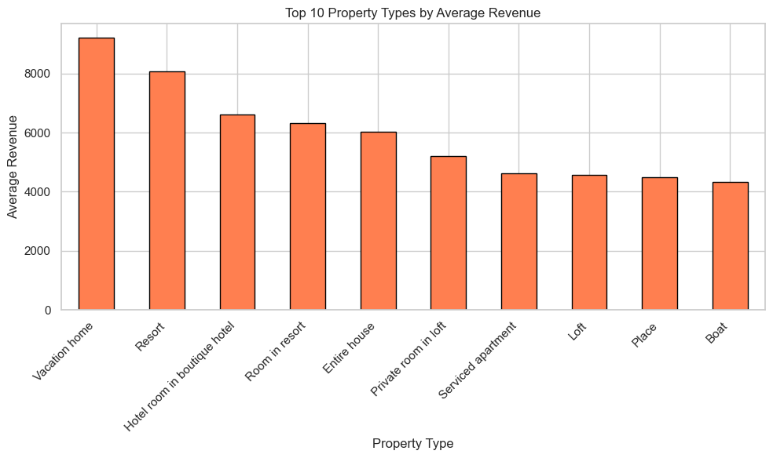
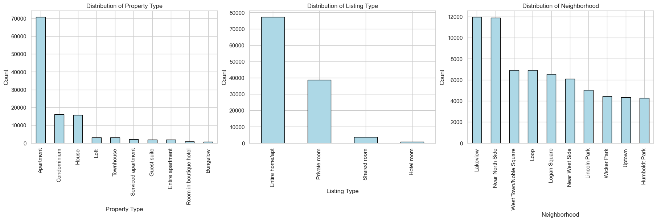
Exploratory Data Analysis

Slide 11
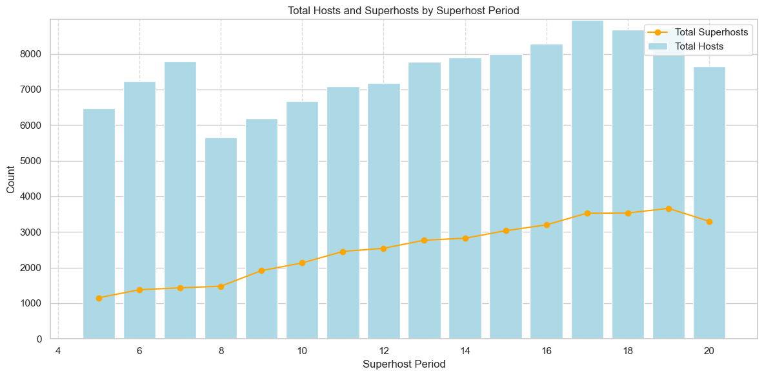
Exploratory Data Analysis
This chart shows the growth in total hosts (blue bars) and superhosts (orange line) over time. While total hosts increase consistently, superhosts grow more gradually, with a slight decline in later periods. These trends highlight the dynamics of superhost status, aiding in understanding patterns for predictive modeling.

Slide 12

a
Data Pre-processing
Reducing the dimensionality of the dataset and normalizing features decreases computational load and enhances the speed of model training and evaluation, ensuring efficient resource utilization while maintaining accuracy.
Using gradient boosting for null imputation and meticulously managing missing values ensures the dataset is both complete and informative, which is essential for enhancing predictive model performance.
Improve Model Performance
Optimize Computational Efficiency
Data
Preprocessing
Facilitate Interpretability
Simplifying the dataset by transforming or scaling variables ensures that the data is easier to interpret and analyze. This aids stakeholders in drawing meaningful insights and understanding relationships between variables, improving decision-making processes.
Eliminating null values from columns where imputation could introduce bias preserves the dataset's integrity, ensuring the analysis remains unaffected by artificially generated data
Balance Bias-Variance Tradeoff
Enhance Data Quality
Eliminating unnecessary and strongly correlated columns enhances the dataset's reliability and overall quality
Addressing multicollinearity and removing correlated features results in models that are more robust and better generalized
Reduce Overfitting Risk
Notes:
© Copyright PresentationGO.com – The free PowerPoint and Google Slides template library

Slide 13

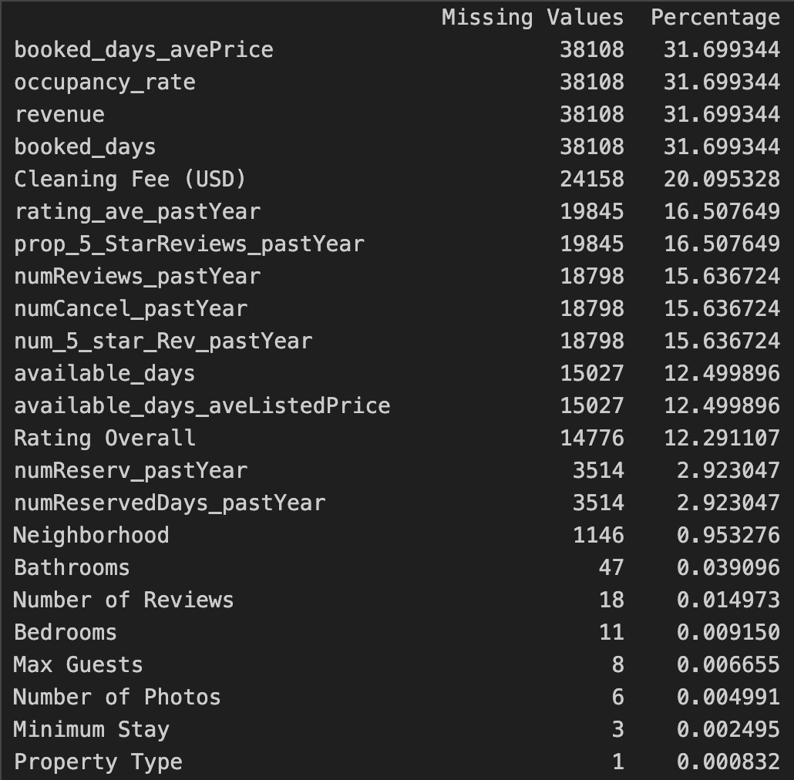


Data Pre-processing
Level I- Managing Missing Data and Identifying Outliers
Data Sources
Outlier Detection
Missing Data
Chicago Airbnb Dataset
95 features
Processed Data for Analysis
35 relevant features
Understanding Outliers
Box-Plots, Stacked Charts Creation
Interpretation and Action plan
Outliers were detected but preserved to reflect real-world scenarios and capture variability of real-world host behavior on performance metrics.
Dropping features with high percentage of missing values.

Slide 14



Data Pre-processing
Level II- Data Adjustment and Aggregation
Gradient Boosting > Mean Imputation
Ability to model complex data relationships
Effectiveness in capturing non-linear feature interactions
Robustness against outliers
Transform property-level data into host-period-level data for analysis.
Simplify dataset while retaining key metrics for modeling and insights.
Group Data: By Airbnb Host ID and superhost_period_all
Apply Aggregation:
Numerical Fields: Mean or median (e.g., reviews, ratings, revenue).
Categorical Fields: Mode (e.g., property type).
Binary Flags: Maximum (e.g., superhost status).
Feature Selection:
Directly relevant to superhost evaluation criteria.
Enhance prediction accuracy while maintaining interpretability.

Slide 15
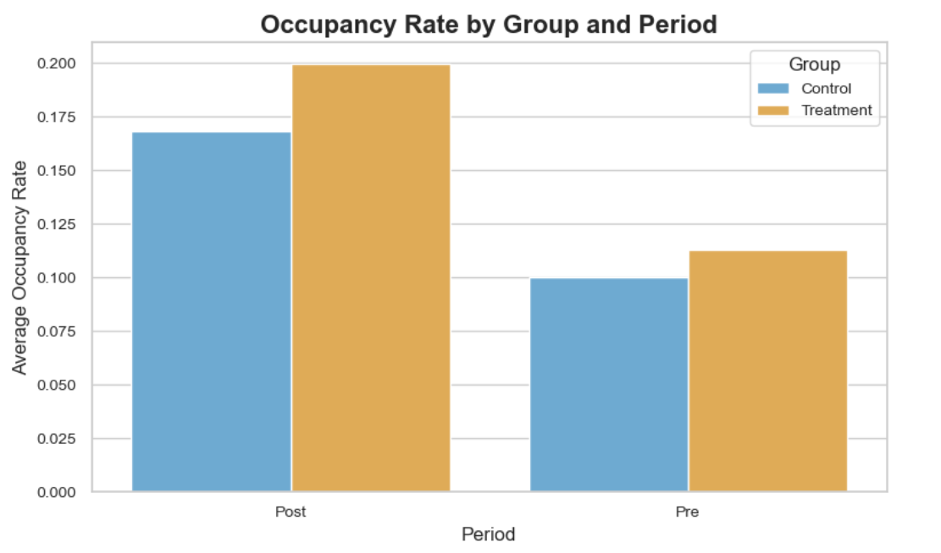
Causal Impact Analysis | Impact of Superhost Status on Occupancy Rates
Control Group-
Hosts who were not superhosts in the pre-period (Period 19) and the post-period (Period 20), serving as the baseline for comparison.
Treatment Group-
Hosts who were not superhosts in the pre-period (Period 19) but became super hosts in the post-period (Period 20).
Treatment Timeline-
Pre-Treatment: Period 19
Post-Treatment: Period 20
Difference of Differences effect is 1.81%
Null Hypothesis H_{o}: Gaining superhost status does not lead to a significant increase in occupancy rates between the pre-period (Period 19) and the post-period (Period 20).
Alternate Hypothesis H_{a}: Gaining superhost status leads to a significant increase in occupancy rates between the pre-period (Period 19) and the post-period (Period 20).
The Formula for calculating the Difference of Differences (DiD) is:
DiD = (Treatment Group Post Treatment – Treatment Group Pre Treatment) – (Control Group Post Treatment – Control Group Pre Treatment)

Slide 16



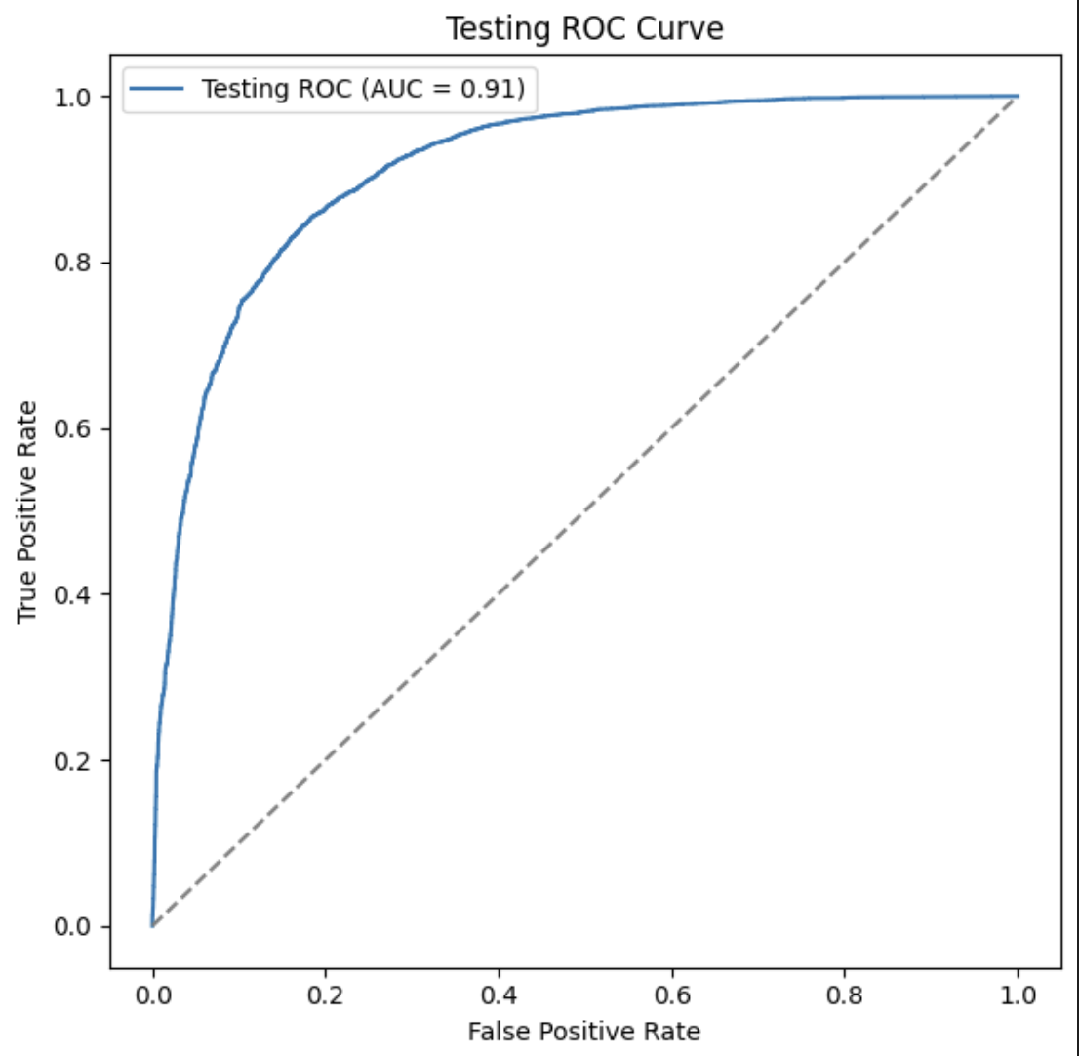
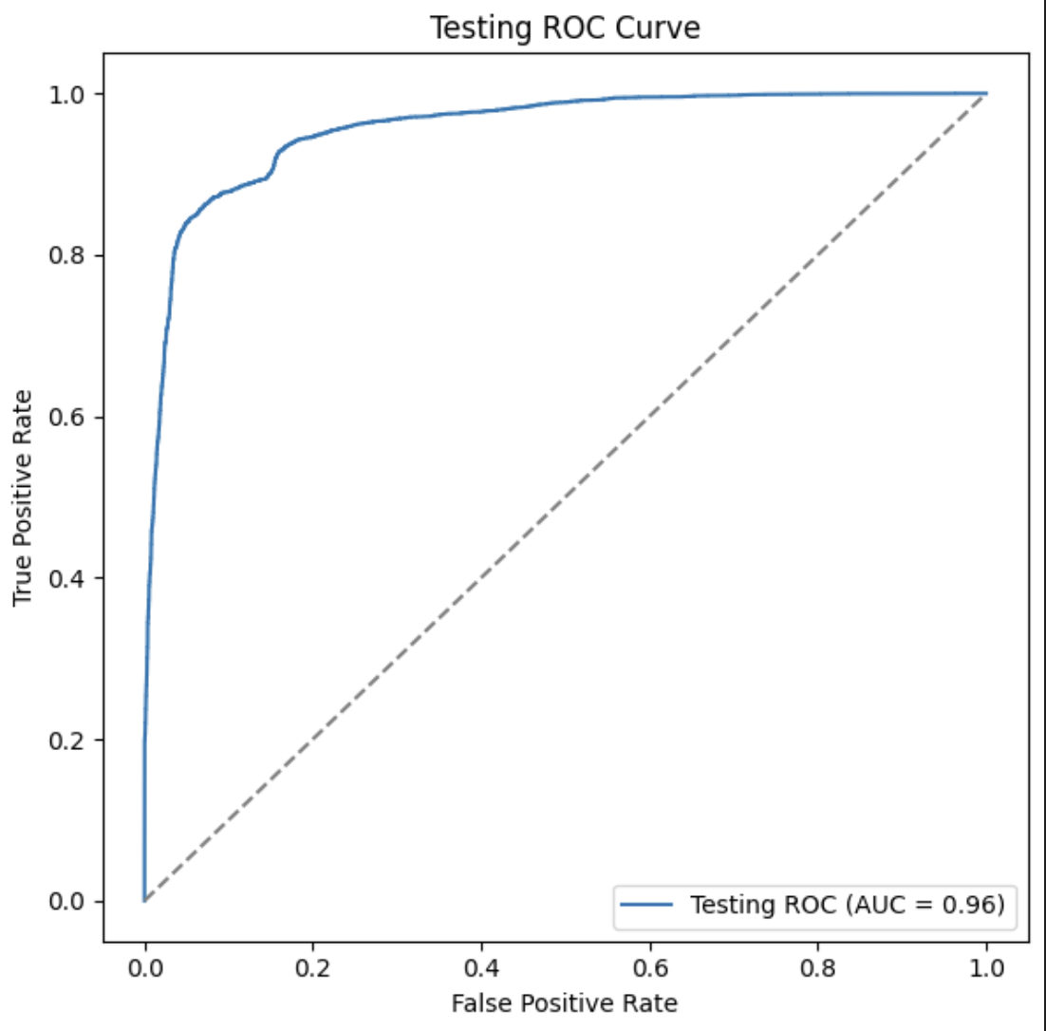
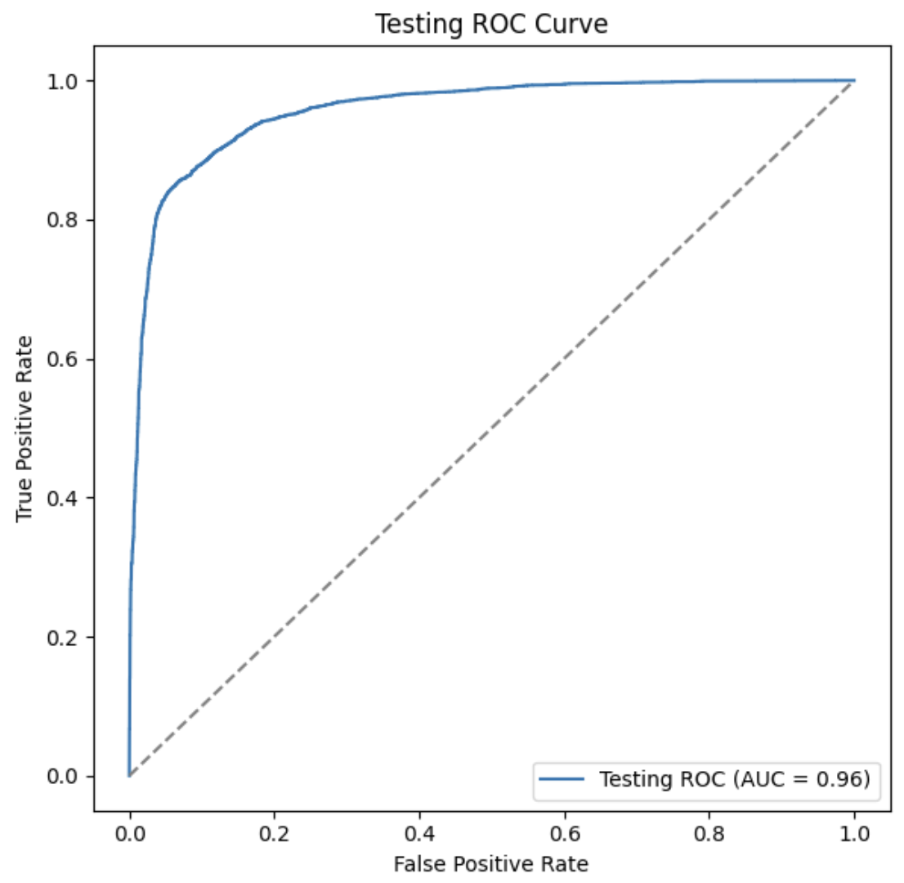
Predictive Modelling | Models Explored
Logistic Regression
Random Forest
Gradient Boosted Trees*
Airbnb Dataset for Chicago from Period 5-20
Training Data: Period 5-14
Testing Data: Period 15-19
Airbnb Dataset for Chicago from Period 5-20
Training Data: Period 5-14
Testing Data: Period 15-19
Airbnb Dataset for Chicago from Period 5-20
Training Data: Period 5-14
Testing Data: Period 15-19

Slide 17
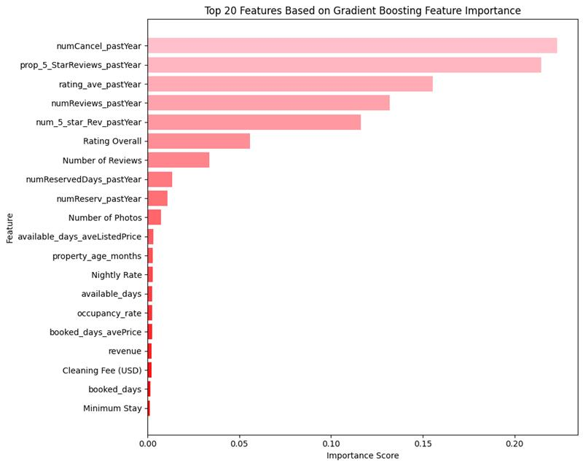



Superhost Prediction | Gradient Boosted Trees
Results & Insights
For Period 20:
Actual Superhosts: 1235
Non- Actual Superhosts: 953
For Period 21:
Predicted Superhosts: 1285 Non-Actual Superhosts: 903
Visual appeal plays a crucial role. Listings with more photos are often more engaging, attracting higher bookings and fostering positive guest feedback.
Pay attention to booking activity and frequency, reflecting the host's availability, appeal to guests, and overall popularity and performance
Status | Precision | Recall | f1-Score
0.0 | 0.83 | 0.92 | 0.87
1.0 | 0.93 | 0.86 | 0.90
The age of a property enhances its credibility, as established listings often have more reviews, upgrades based on feedback. They gain higher visibility on Airbnb and are perceived as reliable, making them appealing to guests, driving bookings and improved occupancy rates.

Slide 18

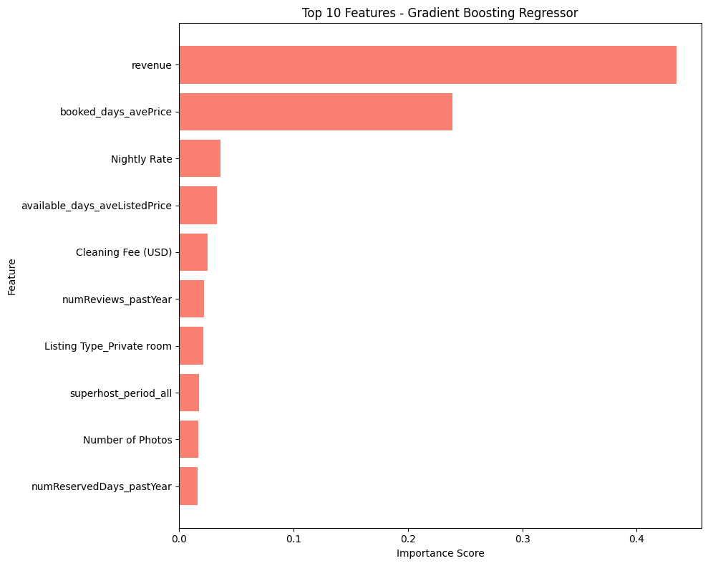

Occupancy Rate Prediction | Gradient Boosted Trees
Dynamic Pricing and Revenue Maximization: Predicting occupancy rates allows Airbnb to recommend dynamic pricing strategies, optimizing revenue for both the platform and hosts by adjusting rates based on demand forecasts.
Geographic and Platform Optimization: By analyzing occupancy trends, Airbnb can identify high-demand locations, guide geographic expansion, and improve platform availability to enhance guest satisfaction.
Operational Efficiency: Hosts can better plan maintenance, restocking, and property upgrades to align with high or low occupancy seasons, ensuring optimal preparation and guest experience.
Revenue and Booking Management: Occupancy rate predictions empower hosts to adjust pricing, fees, and promotions to maximize revenue and secure consistent bookings during varying demand periods.
Model Comparison | Linear Regression | Gradient Boosted Trees
MAPE | 3.50% | 2.54%
RMSE | 0.14 | 0.13
MSE | 0.021 | 0.017

Slide 19
Recommendations & Future Scope
Promote Neighborhood-Specific Insights
Implementation: Highlight successful neighborhoods through targeted campaigns and performance data collection.
Hosts: Helps hosts align property improvements and future investments with high-performing neighborhood standards.
Airbnb: Strengthens the platform's reputation by showcasing top-quality locations.
Introduce Photo Enhancement Tools:
Implementation: Provide photo optimization and AR tools to let guests explore properties in 3D, offering a realistic view of the space and boosting trust before booking.
Hosts: AR tools make listings stand out by offering an interactive and immersive experience, increasing booking potential and establishing credibility with guests.
Airbnb: Integrating AR creates a cutting-edge, visually engaging platform that enhances guest confidence, improves the overall booking experience, and boosts platform usage and retention rates.
Integrate Customer Data for Enhanced Analysis
Implementation: Combine host and customer data, such as booking preferences and feedback, to identify trends and help hosts tailor their listings to meet guest expectations more effectively.
Hosts: Gain a deeper understanding of customer preferences, allowing them to customize offerings (e.g., amenities, pricing, and communication) to better meet guest expectations and bookings.
Airbnb: Refined analysis through customer data enhances the platform's ability to match guests with suitable properties, improving the guest experience and fostering loyalty.

Slide 20


Actionable Business Insights & Strategies
Enhance Search Algorithms: Incorporating Superhost predictors such as booking frequency and photo quality into search algorithms can improve user experience by showcasing high-quality listings.
Encourage Comprehensive Listings: Listings with detailed descriptions, high-quality photos, and guest-centric features improve the platform's overall reputation and guest satisfaction.
Leverage Data for Targeted Support: Data-driven insights on Superhost predictors, such as review quality and booking consistency, enable Airbnb to design tailored support programs for hosts.
Listing Visuals Impact Success: Properties with more high-quality photos see higher engagement and bookings. Improving listing visuals can significantly boost a host's occupancy rate and reviews.
Review Volume and Quality Matter: A higher number of reviews and better overall ratings improve visibility and credibility, leading to increased bookings.
Performance Metrics Drive Success: Metrics such as cancellation rates and response times directly impact Superhost predictions. Hosts should monitor and improve these metrics for better results.
Improved Booking Experience: Listings with more photos and detailed descriptions make the booking process smoother and more reliable for guests.
Trust in Superhost Listings: Guests benefit from higher confidence in Superhost properties, as they consistently offer better quality stays and positive experiences.
Ease of Decision-Making: Data-driven insights on listings, such as ratings, cancellation policies, and amenities, streamline the decision-making process, enhancing guest satisfaction.

Slide 21
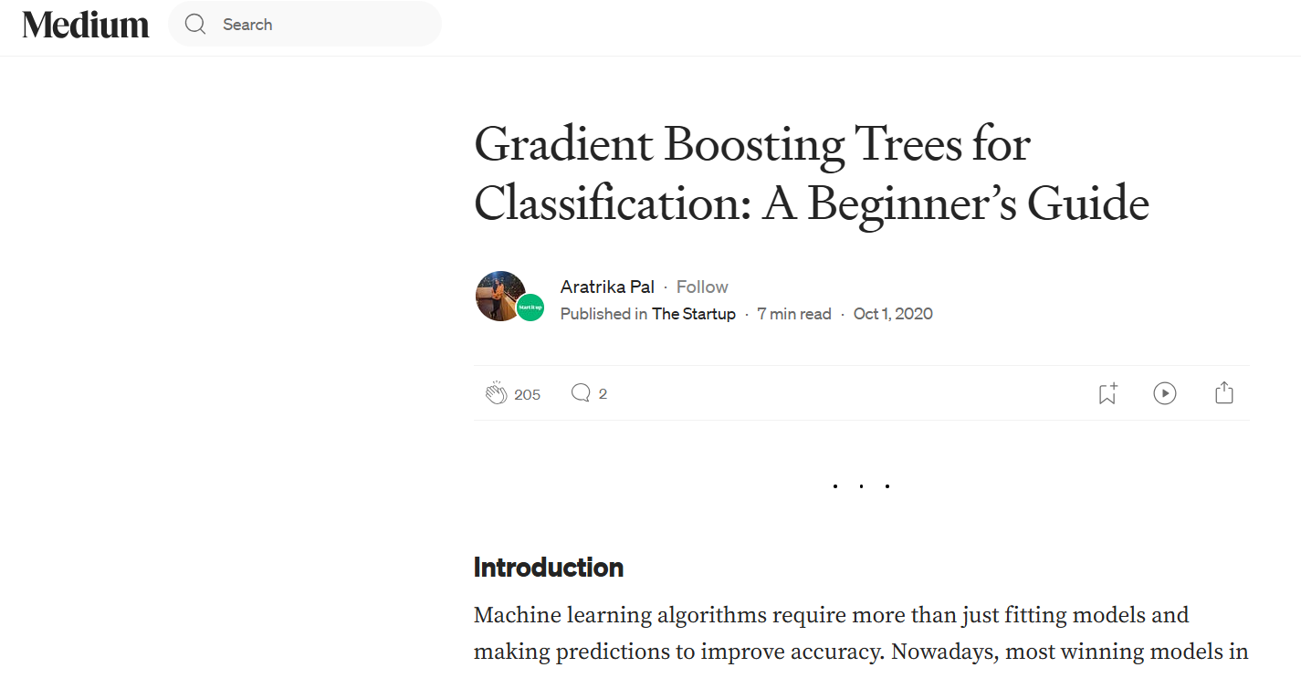





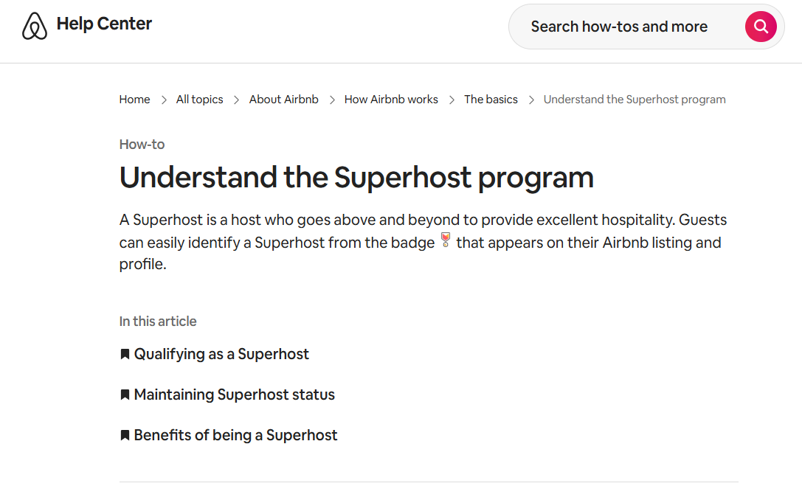

References
https://medium.com/swlh/gradient-boosting-trees-
https://knowledge.uchicago.edu/record/3159
https://www.bgsu.edu/content/dam/BGSU/college-of-arts-and-sciences/
https://www.airbnb.com/help/article/828

Slide 22
*All copyrights to respective owners
Thank You for Listening.
Team 7
Prashast Vaish,
Vishnu Anand,
Swanand Gaikwad

